Slide 1









K.R. MANGALAM UNIVERSITY
SIGNATURE
FORGERY
BY TEAM "NB"

Slide 2



PROJECT OVERVIEW
A model which helps us in knowing whether the signature is real or forged.

Slide 3



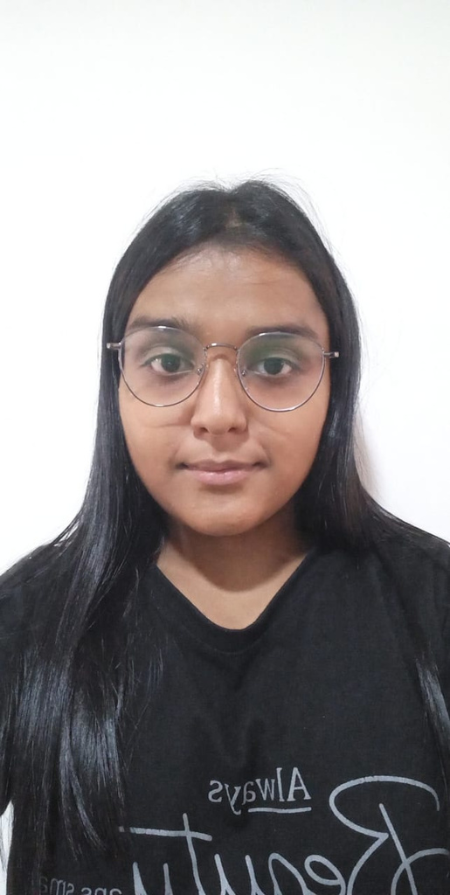
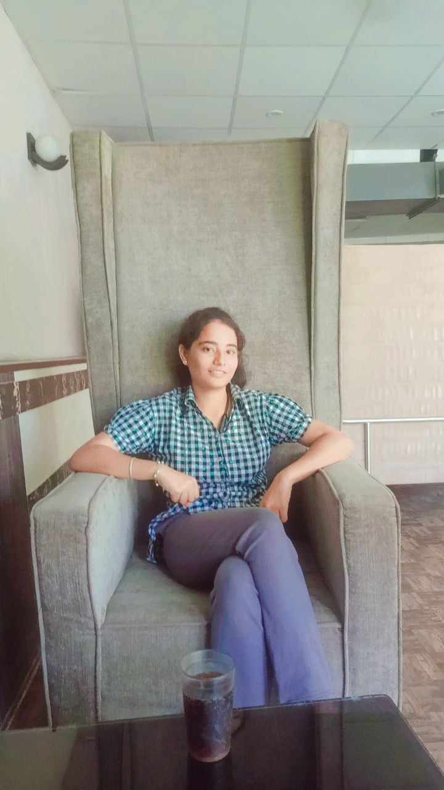

TEAM NB
BHOOMIKA JAIN
NAINA SHARMA
(DEVELOPER
PROJECT MANAGER)
(DEVELOPER
PROJECT MANAGER)

Slide 4



PROBLEM STATEMENT
Signatures can be forged easily now a days which results in huge losses of the people. The idea arrived from the topic of forged documents of lower or backward classes and the main aspect of this type of theft is signature forgery .Due to copying or duplicacy of signatures a lot of benefits which other backward classes should get are taken by others. In banking areas as well before getting the cheques in machine how we can check the signature before by using simply an app? or in industries we can know who is our rival who is doing forged signature in a particular notary document?

Slide 5
SOLUTION
So the solution that we can have is the model that can differentiate between the real and forged signature. That can give max to max accuracy. and tell us the percentage of similarity between two signatures
.The app can have both browse option as well capture option so that it can be used by user easily...

Slide 6


TECHSTACK
The whole model is made using python language and its modules like tkinter, sci-kit image, open cv and os module for recognition of structure of the signature to do comparison between them. It is based on unsupervised learning.

Slide 7
SCALABILITY ND COMMERCIABLITY
It can be used widely by the people as it is freely available to everyone and if the application is made then it can download through app stores. It will have a vast scope in industries and in government sectors for making the work of people easier and convenient

Slide 8
UNIQUENESS
It can be used in any industry and it can detect online signatures (done digitally) and offline (physical signatures) both. It will be a open source model and give the actual rights of the person who owned it.

Slide 9

THANK YOU

